Slide 1
Home Automation System Using Google Assistant
GROUP ID- BCA20C001

Slide 2
Under the guidance’s of
Presented by
Beauty Khatoon
Rishi Jaiswal
Shubham Singh
Ashar Uddin
Vinay Summan
P. Vandana
Mr.Gunjan Mukherjee
Assistant Professor Department of Computational Science Brainware University

Slide 3
Content
Introduction
Block Diagram
Components Required
Sinric Pro and Google Assistants Connectivity
Arduino and ESP-01 Connectivity
ESP-01 Connectivity to the Internet
Arduino Code
ESP-01 Code
Benefits Of Home automation Project
Future Scope of the Project
Conclusion

Slide 4
Introduction
Home automation involves introducing a degree of computerized or automatic control to certain electrical and electronics system in a building.
Home automation” refers to the automatic and electronic control of household features, activity, and appliances. In simple terms, it means you can easily control the utilities and features of your home via the Internet to make life more convenient and secure.
These includes lighting, temperature control, etc... this paper demonstrate a simple home automation system which contains a remote mobile host controller and several client module (home appliances).
The client modules communicate with host controllers through a wireless device such as an android based smart phone.

Slide 5

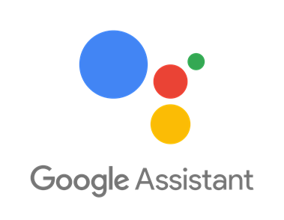
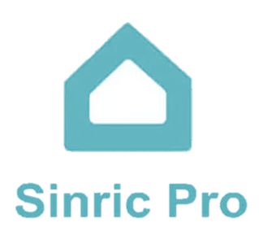
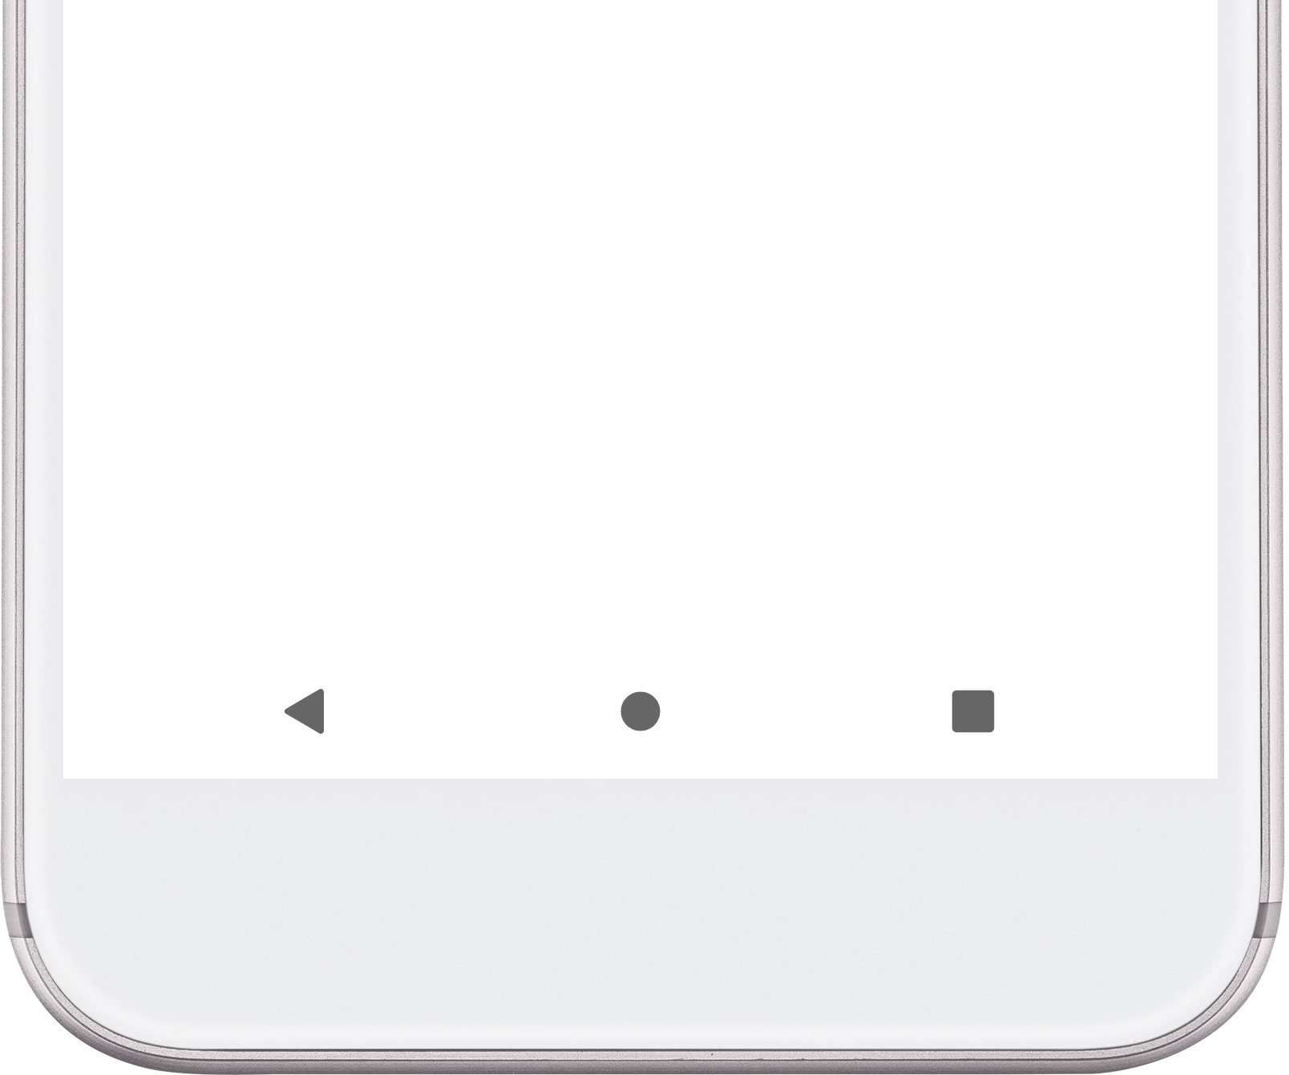

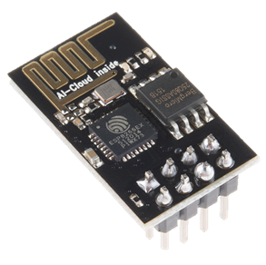

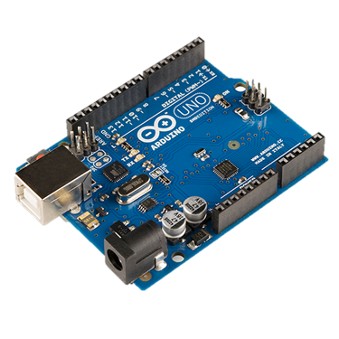

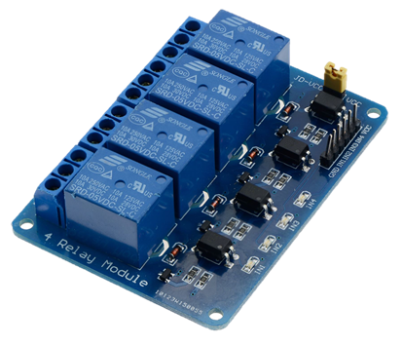

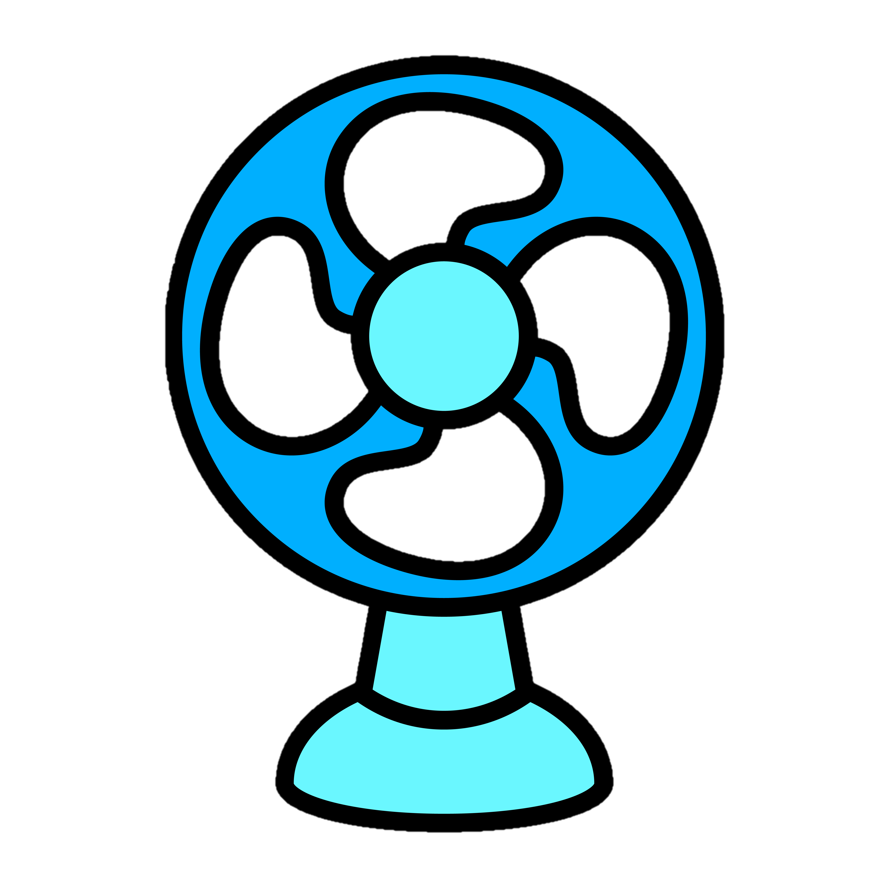

Block Diagram
Light ON/OFF
Fan
ON/OFF

Slide 6

Components Required
Arduino UNO
Arduino UNO is a micro controller board based on the ATmega328P.
Plug in the UNO development board and the driver will be installed automatically, simply connect it to a computer with the supplied USB cable or power it with an AC to DC adapter or battery power to get started.
UNO R3 new improvement, the printing on the female connector is clearer, more precise, more convenient to use wires

Slide 7

Components Required
ESP-01
The ESP-01 ESP8266 Serial WIFI Wireless Transceiver Module is a self-contained SOC with integrated TCP/IP protocol stack that can give any microcontroller access to your WiFi network.
The ESP8266 is capable of either hosting an application or offloading all Wi-Fi networking functions from another application processor.

Slide 8
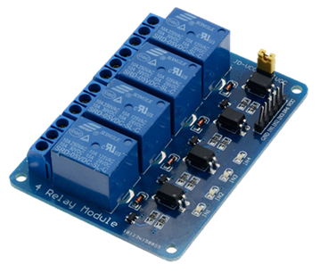
Components Required
Relay Module
A relay is an electrically operated switch having a set of input terminals for a single or multiple control signals and a set of operating contact terminals.
It comprises of components that make switching and connection easier and act as indicators to show if the module is powered and if the relay is active or not.

Slide 9
Components Required
Sinric Pro
With Sinric Pro, you can connect your IoT development board to Alexa and Google Assistant with a reliable skill.
Sinric Pro supports all IoT device types and offers Python, C++, NodeJS libraries with examples to get you up-and-running within minutes.
For advanced users, you can create your own custom devices, set up rooms and routines, and monitor all your devices

Slide 10
Components Required
Google Assistant
Google Assistant is a virtual assistant software application developed by Google that is primarily available on mobile and home automation devices.
Based on artificial intelligence, Google Assistant can engage in two-way conversations, unlike the company's previous virtual assistant, Google Now.

Slide 11
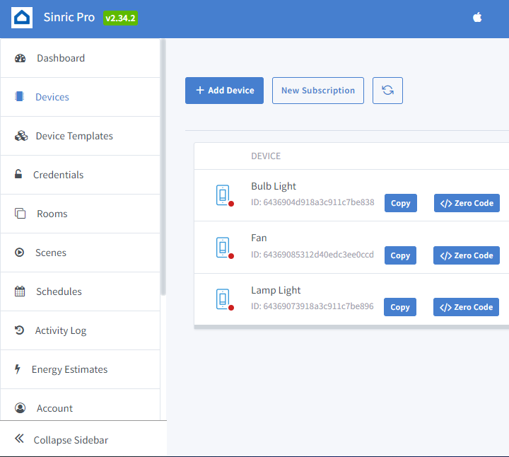
Sinric Pro and Google Assistants Connectivity
Step 1:-
Sign in to your Sinric Pro account and go to the Devices page.
Click on the "Add Device" button.
Select the device type you want to add (e.g. Smart Light, Smart Switch, etc.).
Choose a name for your device and enter any necessary information, such as the device's MAC address or IP address.
If your device requires authentication (e.g. a username and password), enter that information as well.
Click the "Create Device" button.
Your device will now be added to your account, and you can start using it with Sinric Pro.

Slide 12
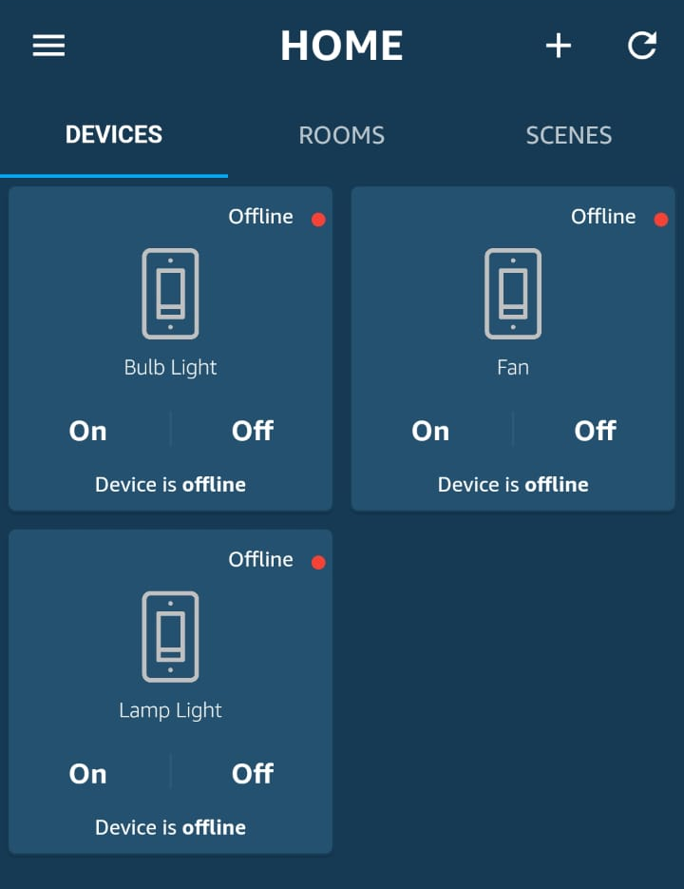
Sinric Pro and Google Assistants Connectivity
Step 2:-
Open the Google Home app on your mobile device.
Tap on the "+" icon to add a new device.
Select "Set up device".
Search for "Sinric Pro" and select it.
Sign in to your Sinric Pro account.
Select the device(s) you want to connect to Google Assistant.
Authorize Sinric Pro to access your Google Assistant account.
Once you have completed the setup, you can use voice commands with Google Assistant to control your Sinric Pro devices.
For example, you can say "Hey Google, turn on the light" to turn on a smart light connected to Sinric Pro. Note that you may need to specify the name of your device as it appears in your Sinric Pro account.

Slide 13
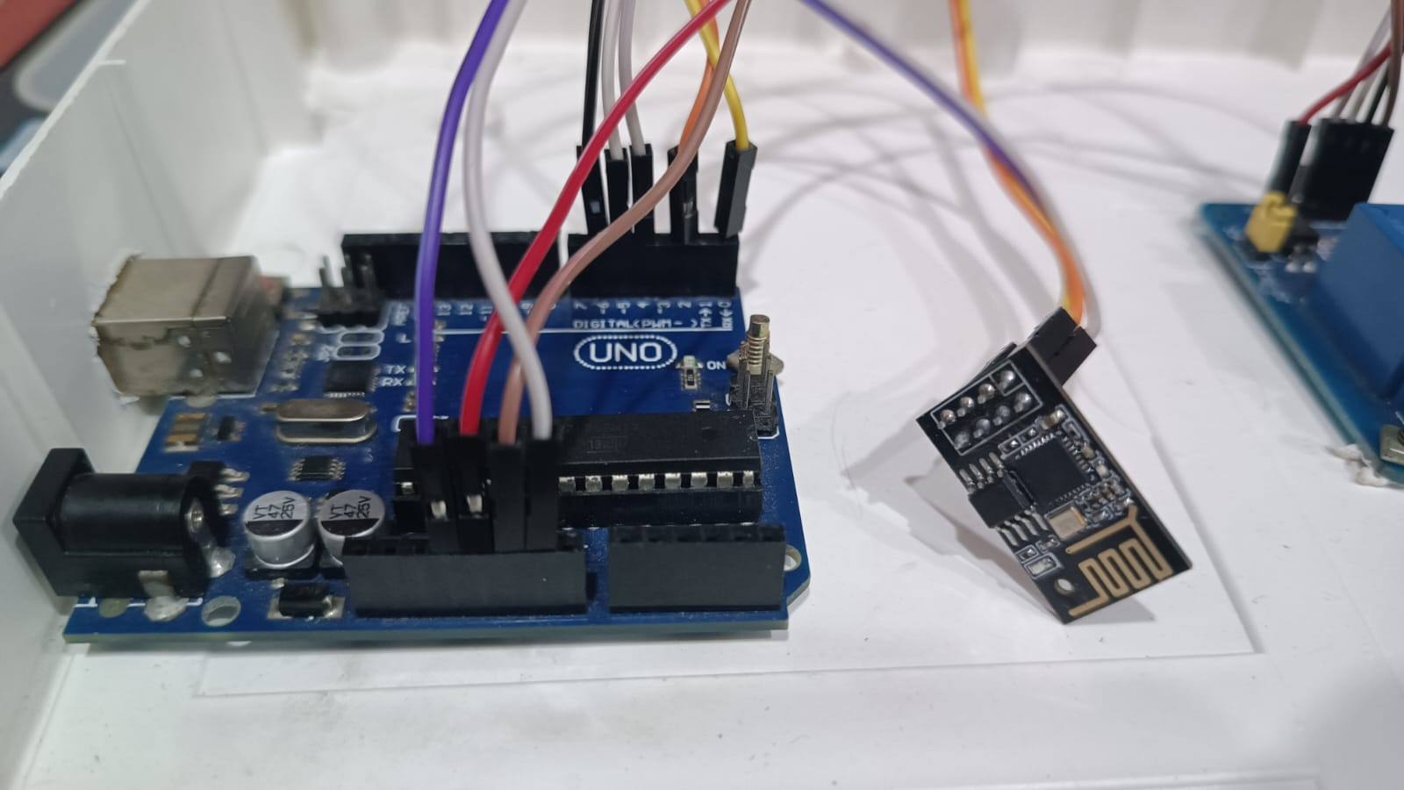
Arduino and ESP-01 Connectivity
Wiring using ESP Board, Arduino UNO
**Need to be connected during Flashing/uploading program only
ESP(3V3) ----> UNO(3.3V)
ESP(EN) ----> UNO(3.3V)
ESP(TX) ----> UNO(TX)
ESP(RX) --> UNO(RX)
ESP(100) ----> UNO(GND)
ESP(GND) -----> UNO(GND)
UNO(RESET) ----> UNO(GND)
Install Ardunio IDE application, Run it,
Select generic ESP8266 board using board manager (you may need to install the board), Select COM Port and upload the program.

Slide 14
ESP-01 Connectivity to the Internet
Steps:-
Open the Arduino IDE and select the appropriate board and port.
Now write the code in Arduino IDE-

Slide 15
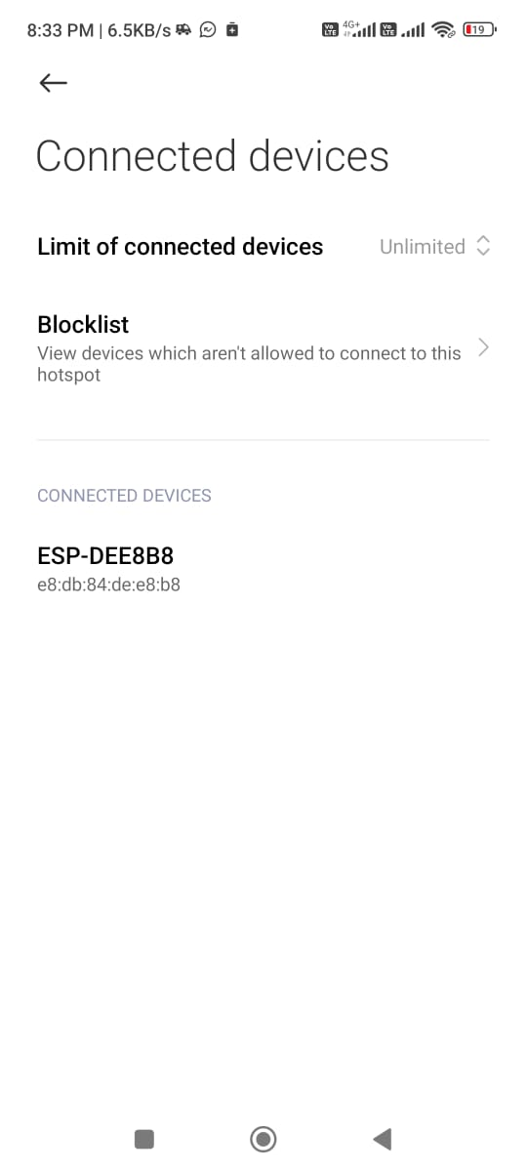
ESP-01 Connectivity to the Internet
Steps:-
Now upload the code and restart the ESP-01
Now the ESP-01 is connected to the internet

Slide 16
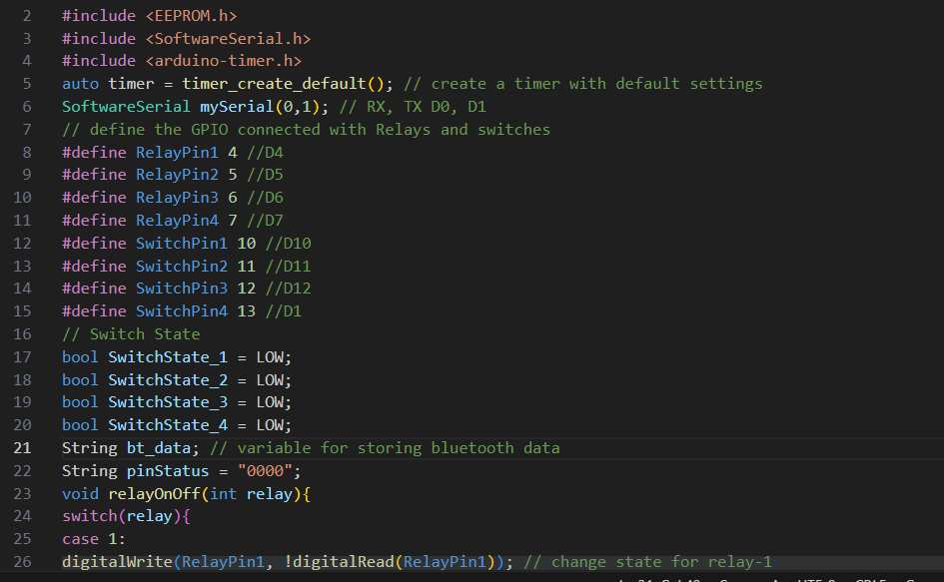
Arduino Code

Slide 17
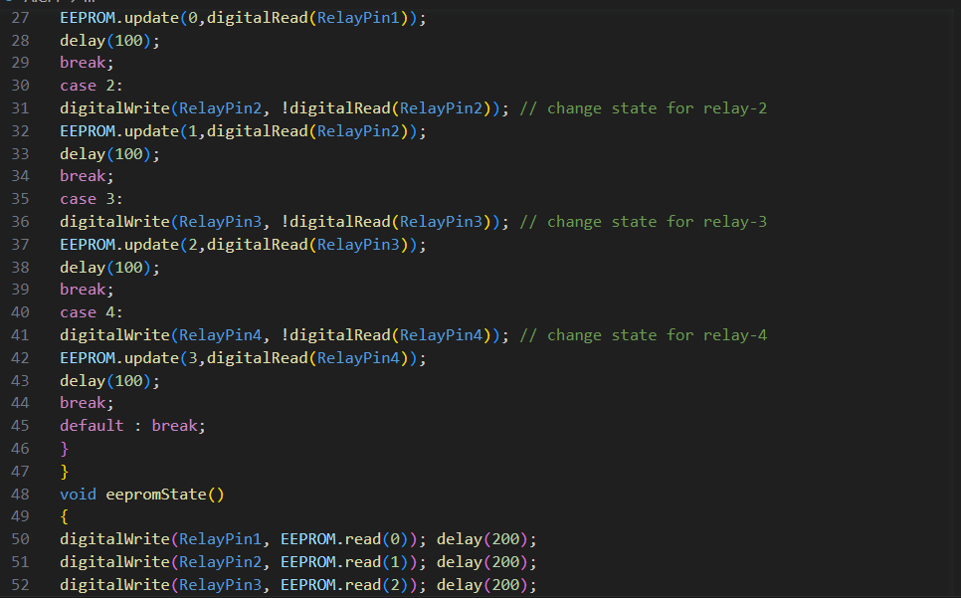
Arduino Code

Slide 18
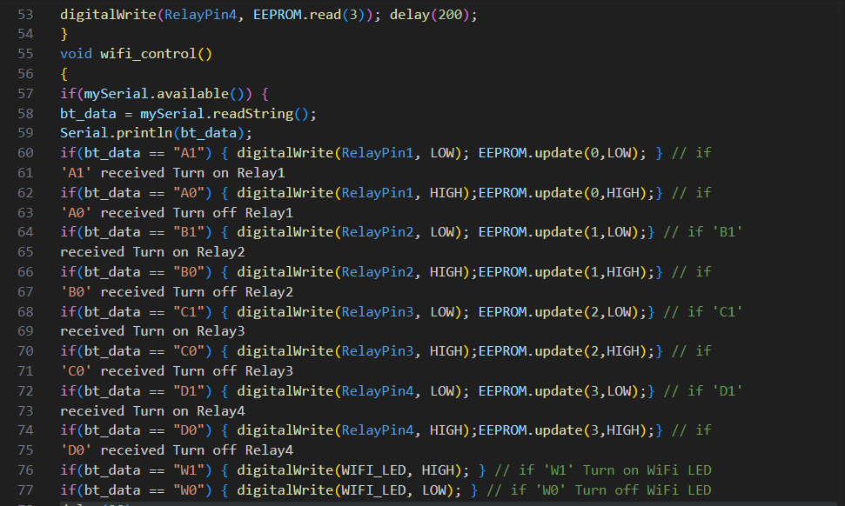
Arduino Code

Slide 19
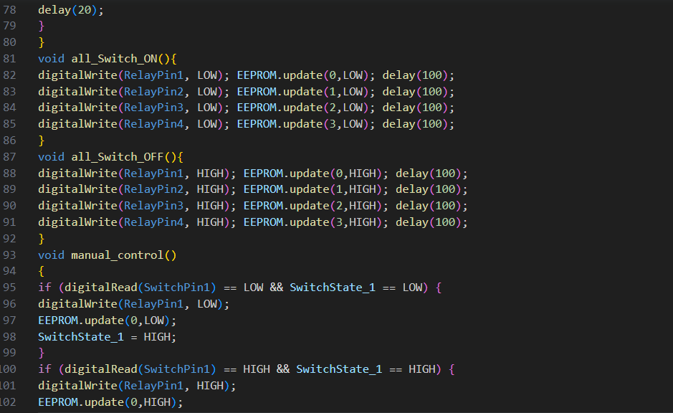
Arduino Code

Slide 20
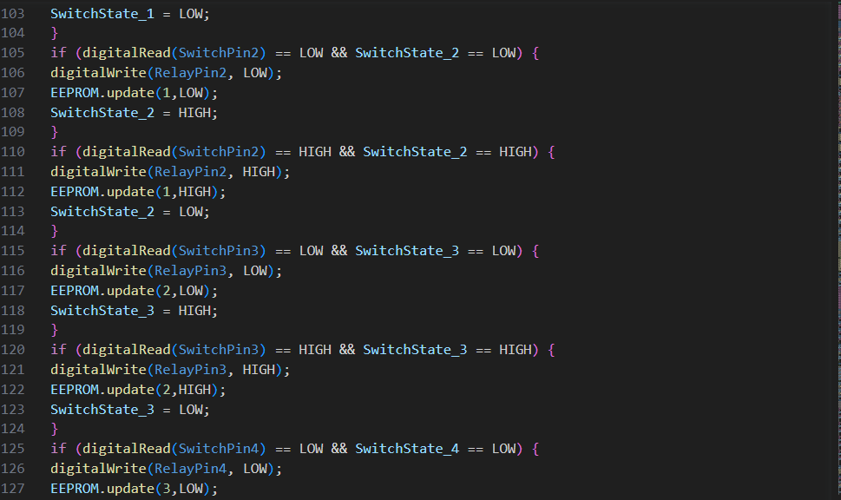
Arduino Code

Slide 21
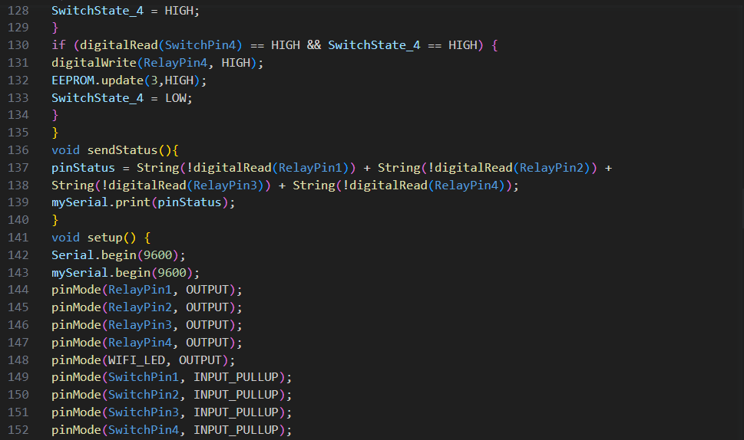
Arduino Code

Slide 22
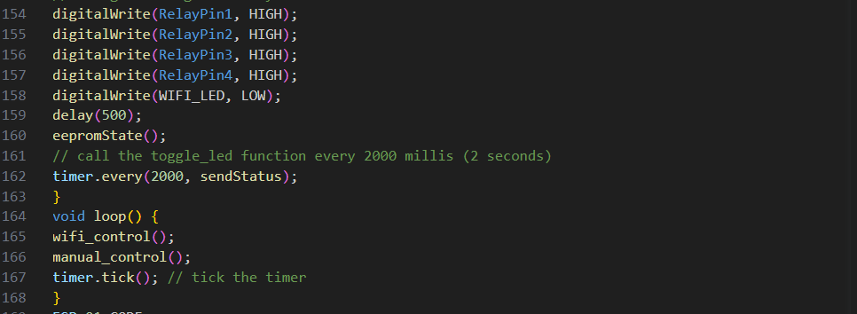
Arduino Code

Slide 23
Arduino Code

Slide 24
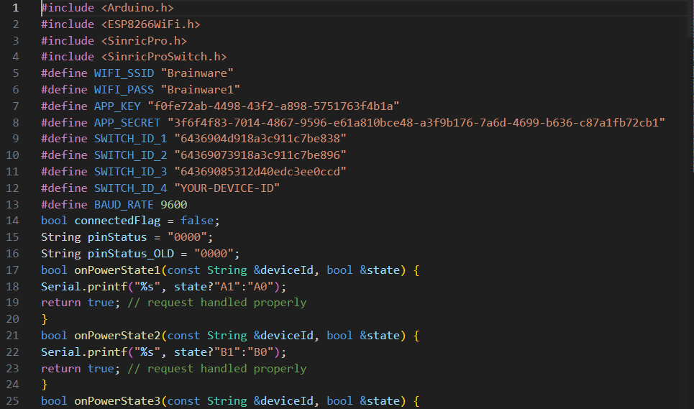
ESP-01 Code

Slide 25
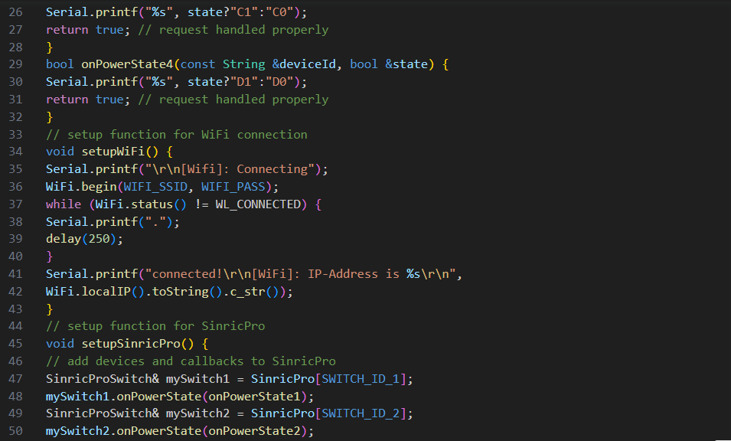
ESP-01 Code

Slide 26
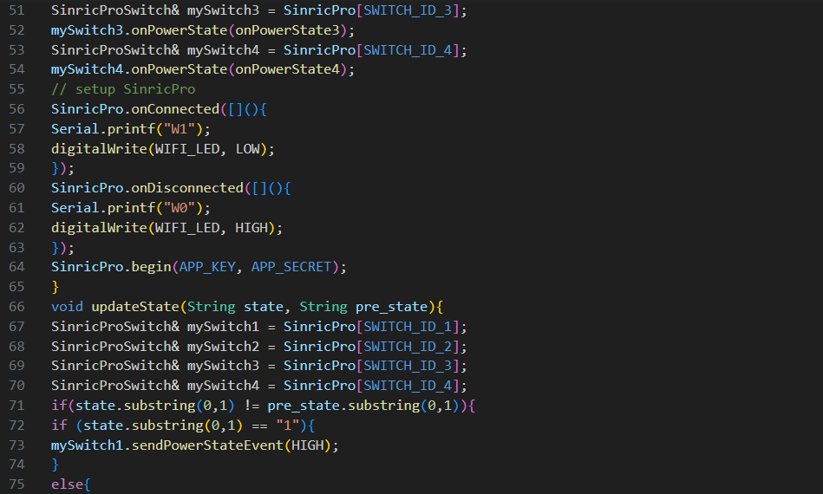
ESP-01 Code

Slide 27
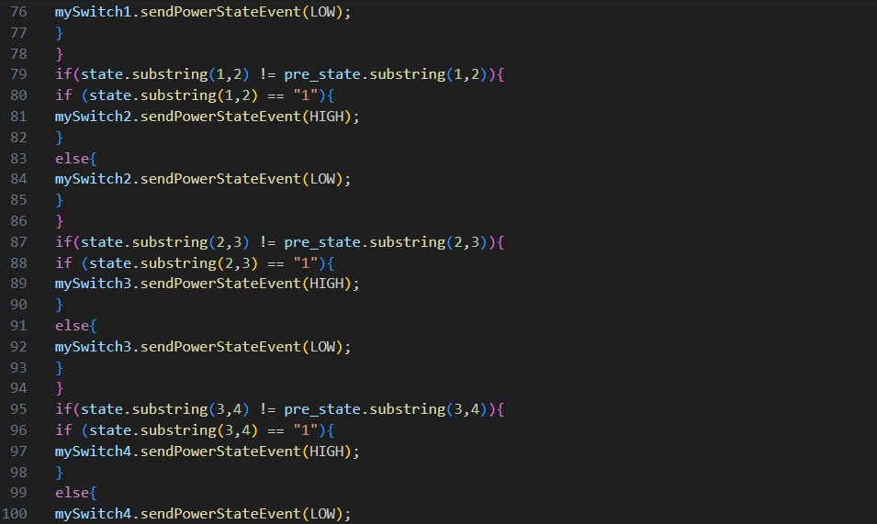
ESP-01 Code

Slide 28
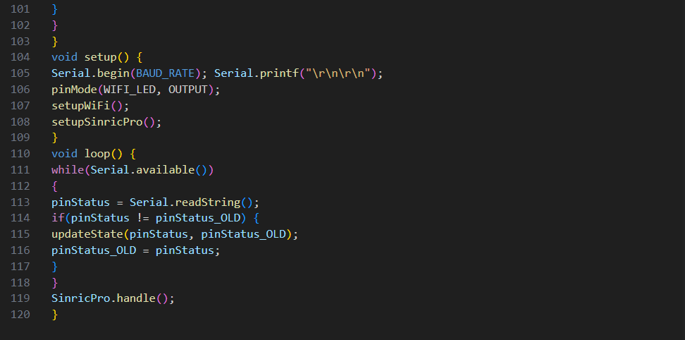
ESP-01 Code

Slide 29
Benefits Of Home automation Project
1. Convenience: Home automation allows you to control your devices and appliances remotely, providing you with convenience and flexibility. With the integration of Google Assistant and Sinric Pro, we can control our devices using voice commands, making it effortless to manage our home environment.
2. Energy Efficiency: Home automation systems enable us to optimize energy consumption. We can schedule devices to turn on and off automatically or control them remotely. For example, we can turn off lights, fans, or appliances when not in use, leading to energy savings and reducing our electricity bills.
3. Customizability: One of the advantages of building own home automation project is the ability to customize it according to our specific needs. We can choose the devices and functionalities we want to integrate into our system and tailor it to match our preferences.
4. Scalability: Arduino UNO and ESP01 are versatile platforms that allow for easy expansion and scalability. We can add more devices, sensors, or modules to our home automation system in the future, enabling us to gradually build and expand our smart home setup as our needs evolve.

Slide 30
Benefits Of Home automation Project
5. Learning Experience: Undertaking a project like this provides an excellent learning experience. We will gain hands-on experience with programming, electronics, and hardware integration. This project will enhance our understanding of Arduino, ESP01, relay modules, and IoT (Internet of things) technologies, which can be valuable for future career opportunities.
6. Cost-Effectiveness: Building our own home automation project using Arduino and ESP01 can be cost-effective compared to purchasing commercial smart home solutions.
7. Integration with Google Assistant: By integrating our project with Google Assistant, we can leverage the power of voice commands to control our devices. It adds convenience by allowing us to control our home environment without physically interacting with switches or remotes

Slide 31
Future Scope of the Project
The future scope of our home automation project is promising, as the field of home automation continues to evolve and advance.
1. Integration with More Smart Devices: As the Internet of Things (IoT) expands, the number and variety of smart devices available on the market will continue to grow. We can explore integrating our project with a wider range of devices, such as smart thermostats, door locks, window blinds, security cameras, and kitchen appliances. This will allow for more comprehensive control and automation of our home environment.
2. Machine Learning and Artificial Intelligence: Incorporating machine learning and artificial intelligence (AI) into our home automation system can enable it to learn and adapt to your preferences and behavior patterns. This can enhance automation features, optimize energy usage, and provide personalized experiences tailored to individual household members.
3. Voice Assistant Improvements: Voice assistants like Google Assistant are constantly evolving and becoming more advanced. Future improvements in natural language processing and voice recognition technology will lead to more accurate and seamless voice control experiences. Integrating these advancements into our project can enhance user interaction and make our system more intuitive and user-friendly.

Slide 32
Future Scope of the Project
4. Energy Management and Sustainability: With a growing focus on sustainability and energy conservation, there will be increasing demand for home automation solutions that help manage energy usage efficiently. We can explore incorporating features like energy monitoring, smart power management, and renewable energy integration into our project, enabling homeowners to make more sustainable choices and reduce their carbon footprint.
5. Enhanced Security and Privacy: Home security is an area that will continue to see advancements. Integrating advanced security features such as facial recognition, biometric authentication, and advanced encryption protocols can further enhance the security and privacy of our home automation system, ensuring the protection of user data and preventing unauthorized access. By integrating sensors, cameras, and alarms, we can monitor and control our security system remotely. For instance, we can receive notifications on our smartphone if a motion sensor detects movement, allowing us to take immediate action or alert the authorities if necessary.
6. Cloud Integration and Remote Access: Cloud-based integration allows for remote access and control of our home automation system from anywhere in the world. We can explore integrating cloud platforms to store data, receive notifications, and manage our system remotely. This opens up possibilities for additional functionalities, such as data analytics, system monitoring, and remote troubleshooting.

Slide 33
Future Scope of the Project
7. Smart Home Ecosystems: The future of home automation lies in the development of interconnected smart home ecosystems. Integration with other smart devices and platforms, such as wearable devices, voice assistants, can create a seamless and holistic smart home experience

Slide 34
Conclusion
Home automation systems have revolutionized the way we interact with our homes and have become increasingly popular in recent years. These systems offer numerous benefits, including convenience, energy efficiency, improved security, and enhanced comfort.
Home automation systems also contribute to improved security. Integration with security cameras, door locks, and alarm systems enables remote monitoring and control of your home's security. You can receive alerts, view live feeds, and even remotely lock or unlock doors, enhancing the safety of your property.
Furthermore, home automation systems offer enhanced comfort and customization. You can program personalized settings to adjust lighting, temperature, and audiovisual equipment based on your preferences. Smart home assistants, such as voice-activated speakers, provide additional convenience by allowing you to control devices through voice commands.
Home automation systems have the potential to significantly enhance our daily lives by offering convenience, energy efficiency, security, and customization. While there may be initial costs and considerations for compatibility and security, the benefits make home automation an attractive option for modern homeowners seeking a more streamlined and efficient living environment.

Slide 35
Thank You

